Slide 1
UNIT NO – 3 mensuration & Data interpretation
SUBJECT :QALR
Dr. N. Manjula ASSISTANT PROFESSOR OF MATHEMATICS SCIENCE & HUMANITIES SNIST

Slide 2

Area
FUNDAMENTAL CONCEPTS
Results on Triangles:
Sum of the angles of a triangle is 180*.
The sum of any two sides of a triangle is greater than the third side.
Pythagoras Theorem: In a right angled triangle ${(Hypotenuse)}^{2}={(Base)}^{2}+{(Height)}^{2}$
The line joining the midpoint of a side of a triangle to the opposite vertex is called the median.
The point where the three medians of a triangle meet, is called centroid. The centroid divides each of the medians in the ratio 2:1.
In an isosceles triangle, the altitude from the vertex bisects the base.
The median of a triangle divides it into 2 triangles of the same area.
The area of the triangle formed by joining the mid-points of the sides of a given triangle is one-fourth of the area of the given triangle.

Slide 3
Results on Quadrilaterals:
The diagonals of a parallelogram bisect each other.
Each diagonal of a parallelogram divides it into two triangles of the same area.
The diagonals of a rectangle are equal and bisect each other.
The diagonals of a square are equal and bisect each other at right angles.
The diagonals of rhombus are unequal and bisect each other at right angles.
A parallelogram and a rectangle on the same base and between-the same parallels are equal in area.
Of all the parallelogram of give side, the parallelogram which is a rectangular has the greatest area.

Slide 4

Important Formulae
1) Area of a rectangular = ( Length × Breadth)
Length = $\frac{Area}{Breadth}$ and Breadth = $\frac{Area}{Length}$
2) Perimeter of a rectangle = 2(Length + Breadth).
Area of a square = $({side)}^{2}$ = $\frac{1}{2}$ (${daigonal)}^{2}$
Area of 4 walls of a room = 2 (Length × Breadth) × Height.
3) Area of triangle = $\frac{1}{2}$ × base × Height
4) Area of triangle = $\sqrt{s\left(s−a\right)\left(s−b\right)\left(s−c\right)}$ , where a, b, c are sides of the triangle and s = $\frac{1}{2} \left( a+b+c\right)$
5) Area of equilateral triangle = $\frac{\sqrt{3}}{4} ×({side)}^{2}$

Slide 5

6) Radius of incircle of an equilateral triangle of side a = $\frac{a }{2\sqrt{3}}$
7) Radius of circumcircle of an equilateral triangle of side a = $\frac{a}{\sqrt{3}}$
8) Radius of incircle of a triangle of area $∆$ and semi – perimeter s = $\frac{}{s}$
9) Area of parallelogram = (Base × Height).
10) Area of rhombus = $\frac{1}{2} ×\left(product of diagonals\right)$
11) Area of trapezium = $\frac{1}{2} ×\left(sum of parallel sides\right)×distance between them.$

Slide 6

12) Area of a circle = π$R^{2}$ , Where R is the radius
13) Circumference of a circle = 2πR.
14) Length of an arc =$\frac{2πRθ}{360}$, Where ϑ is the central angle.
15) Area of an Sector = $\frac{1}{2} \left( arc ×R\right)$ = $\frac{πR^{2}θ}{360}$
16) Area of a semi-circle = $\frac{πR^{2}}{2}$
17) Circumference of a semi-circle = $πR$

Slide 7

Problems
1) One of a rectangular field is 15m and one of its diagonals is 17m. Find the area of the field?
Sol) Other side = $\sqrt{{\left(17\right)}^{2}−{\left(15\right)}^{2}}$ = $\sqrt{289−225}$ = $\sqrt{64}$ = 8 m.
Area = $\left(15 ×8\right) m^{2}$ = 120$m^{2}$.
2) The perimeter of two squares are 40 cm and 32 cm. Find the perimeter of the third square whose area is equal to the difference of the areas of the two squares?
Sol) Side of first square = $\left(\frac{40}{4}\right) cm$ = 10 cm.
Side of second square =$\left(\frac{32}{4}\right) cm$ = 8 cm.
Area of third square = $\left[{10}^{2}− 8^{2}\right] {cm}^{2}$ = $\left(100−64 \right) {cm}^{2}$ = $36 {cm}^{2}$
Side of third square = $\sqrt{36} cm$ = 6 cm
Required perimeter = $\left(6 ×4\right) cm$= $24 cm$

Slide 8

3) A room 5m 55cm long and 3m 74cm broad is to be paved with square tiles. Find the least number of square tiles required to cover the floor?
Sol) Area of room = $\left(544 ×374\right) {cm}^{2}$
Size of large square tile = H.C.F of 544 cm and 374 cm = 34 cm
Area of 1 tile = $\left( 34×34\right) {cm}^{2}$
Number of tiles required = $\left(\frac{544 ×374}{34 ×34}\right)$ = 176
4) Find the area of a square, one of whose diagonal is 3.8 m long?
Sol) Area of square = $\frac{1}{2} ×{\left(diagonal\right)}^{2}$ = $\left(\frac{1}{2} ×3.8 ×3.8\right) m^{2}$ = $7.22 m^{2}$.
5) The diagonal of two squares are in the Raito of 2:5 . Find the ratio of their areas?
Sol) Let the diagonal of the squares be $2x$ and $5x$ respectively.
Ration if their areas = $\frac{1}{2 } × {2x}^{2 } : \frac{1}{2} × {5x}^{2}$ = $4x^{2} :25x^{2}$ = 4 : 25.

Slide 9

6) Find the area of the triangle whose sides measure 13 cm, 14 cm and 15 cm?
Sol) Let a = 13; b = 14 and c = 15. Then, s = $\frac{1}{2}\left(a+b+c\right)$ = 21
(s-a) = 8, (s-b) = 7 and (s-c) 6.
Area = $\sqrt{s\left(s−a\right)\left(s−b\right)\left(s−c\right)}$ = $\sqrt{21×8×7×6} =84 {cm }^{2}$
7) Find the area of right- angled triangle whose base is 12 cm and hypotenuse 13 cm?
Sol) Height of the triangle = $\sqrt{{\left(13\right)}^{2}−({12)}^{2}}$ cm = $\sqrt{25 } cm=5 cm$
Its area = $\frac{1}{2}×Base ×Height = \left(\frac{1}{2}×12×5\right) {cm}^{2} =30 {cm}^{2}$

Slide 10
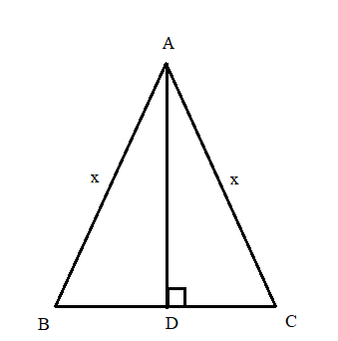

8) The altitude drawn to the base of an isosceles triangle is 8 cm and the perimeter is 32 cm. Find the area of triangle?
Sol) Let ABC be the isosceles of the triangle and AD be the altitude.
Let AB = AC =$x$ Then, BC = $\left(32−2x\right).$
Since the isosceles triangle , the altitude bisects the base, so BD= DC = $\left(16−x\right)$
In $∆ ADC, {AC }^{2}= {AD}^{2}+ {DC}^{2}$ = $x^{2}⇒({8)}^{2}+(16−x^{2})$
$⇒$ 32$x=320⇒ x=10$
BC=$\left(32−2x\right)=\left(32−20\right)cm=12cm$
Hence, required area=$(\frac{1}{2}×BC×AD)$ = $\left(\frac{1}{2}×12×16\right){cm}^{2}=60 {cm }^{2}$

Slide 11

9) Find the length of the altitude of an equilateral triangle of side 3$\sqrt{3}$ cm?
Sol) Area of triangle =$\frac{\sqrt{3}}{4}×(3{\sqrt{3})}^{2}$ = $\frac{27\sqrt{3}}{4}$. Let the height be h.
Then, $\frac{1}{2}×3\sqrt{3} ×h= \frac{27\sqrt{3}}{4} ⇔h=\frac{27\sqrt{3}}{4}×\frac{2}{3\sqrt{3}}= \frac{9}{2}=4.5 cm .$
10) Find the area of a rhombus one side of which measures 20cm and one diagonal 24cm?
Sol) Let other diagonal = 2xcm.
Since diagonals of a rhombus bisect each other at right angles, we have:
$${20}^{2}={12}^{2}{+x}^{2}⇔\sqrt{{20}^{2}{−12}^{2}}=\sqrt{256}=16cm$$
So, other diagonal = 32cm
Area of rhombus = $\frac{1}{2}×\left(Product of diagonals\right)=\left(\frac{1}{2}×24×32\right)sq.cm=384sq.cm$

Slide 12

11) The difference between two parallel sides of a trapezium is 4cm. The perpendicular distance between them is 19cm. If the area of the trapezium is 475 sq.cm, find the lengths of the parallel sides?
Sol) Let the two parallel sides of the trapezium be “a” cm & “b”cm.
Then, a-b=4.________________(1)
And $\frac{1}{2}×\left(a+b\right)×19=475⇔\left(a+b\right)=\frac{475×2}{19}⇔a+b=50$________________(2)
Solving 1 & 2 we get, a=27, b= 23
So the two parallel sides are 27cm & 23cm
12) A sector of 120*, cut out from a circle, has an area of 9$\frac{3}{7}$ sq.cm. find the radius of the circle?
Sol) Let the radius of the circle be r cm, then,
$$\frac{ᴨ{Θr}^{2}}{360}=\frac{66}{7}⇔\frac{22}{7}×r^{2}×\frac{120}{360}=\frac{66}{7}⇔r^{2}=\left(\frac{66}{7}×\frac{7}{22}×3\right)=9⇔r=3$$
Hence radius = 3 cm.

Slide 13
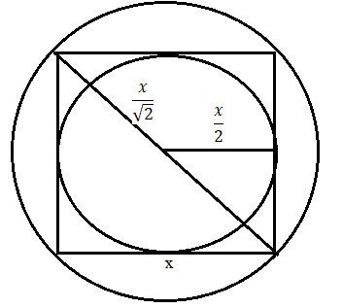

13) Find the ratio of the areas of the in circle and circumcircle of a square?
Sol) Let the side of the square be “x”. Then, its diagonal = $\sqrt{2}x.$
Radius of in circle = $\frac{x}{2} and$
Radius of circumcircle = $\frac{\sqrt{2}x}{2}=\frac{x}{\sqrt{2}}$
Required ratio = $\frac{ᴨr^{2}}{4}:\frac{ᴨr^{2}}{2}=\frac{1}{4}:\frac{1}{2}=1:2$

Slide 14
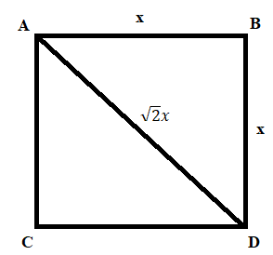

Area of Plan Figures
1) The ratio between the length & perimeter of a rectangular plot is 1:3, what is the ratio between the length & breadth of the plot?
Sol) $\frac{l}{2(l+b)}=\frac{1}{3}⇒l=2b⇒\frac{l}{b}=2$
2) A rectangular carpet has an area of 60 sq.m. If its diagonal and longer side together equal 5 times the shorter side, the length of the carpet is ?
Sol) $lb=60 \& \sqrt{l^{2}+b^{2}}+l=5b⇒b=5mThere four l=12m$
3) A man walked diagonally across “a” sq plot approximately, what was the percent saved by not walking along the edges?
Sol) $AC=\sqrt{2}x=1.414x$
Saving on 2x meters = (0.59x)m
Saving % = $\left(\frac{0.59x}{2x}×100\right)\%≅30\%$

Slide 15
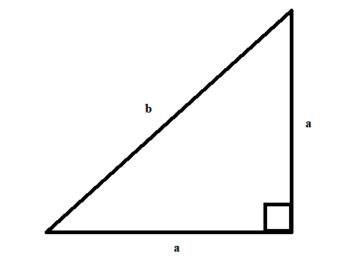
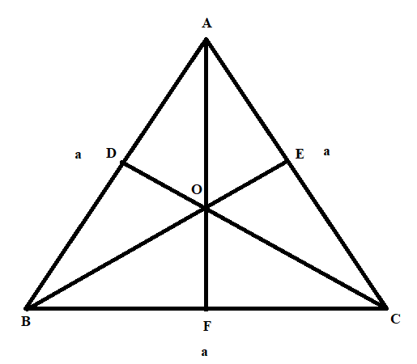

4) If the perimeter of an isosceles right triangle is (6+3$\sqrt{2}$) m, then the area of the triangle is?
Sol) $2a+b=\left(6+3\sqrt{2}\right) \& b^{2}=2a^{2}⇒b=\sqrt{2}a$
$$2a+\sqrt{2}a=6+3\sqrt{2}⇒a=3$$
Area = $\frac{1}{2}×3×3=4.5 sq.m$
5) From a point in the interior of an equilateral triangle, the perpendicular distance if the sides are $\sqrt{3} cm \& 2\sqrt{3 }cm \& 5\sqrt{3 }cm.$ The perimeter of the triangle is ?
Sol) Area of Triangle ABC = Area of 3 interior triangles
Let each side of a triangle is “a” cm.
$$\frac{1}{2}×a×\sqrt{3}+\frac{1}{2}×a×2\sqrt{3}+\frac{1}{2}×a×5\sqrt{3}= \frac{\sqrt{3}}{4}a^{2}⇒a=16cm.$$
$$Permeter=3×a=48cm$$

Slide 16

6) An equilateral triangle is described on the diagonal a square, what is the ratio of the area of the triangle to that of the square?
Sol) $A_{1}:A_{2}=\frac{\sqrt{3}}{4}x^{2}:x^{2}=\sqrt{3}:2$
7) If the diagonals of a rhombus are 24cm & 10cm, the area & the perimeter of a rhombus are ?
Sol) $A1:4x=\frac{1}{2}×24×10 :13×4=120:52$
8) An equilateral triangle, a square and a circle have equal perimeters. If T denotes the area of the triangle, S the area of the square, C the area of the circle?
Sol) Let the perimeter of each be $x$
Then side of equilateral triangle $=\frac{x}{3}$
Side of square = $\frac{x}{4}$
Radius of circle = $\frac{x}{2ᴨ}$
There four $T=\frac{\sqrt{3}}{4}({\frac{X}{3})}^{2}, S={(\frac{X}{4})}^{2}, C={ᴨ(\frac{X}{2ᴨ})}^{2}$

Slide 17
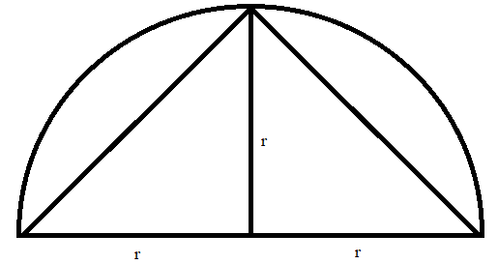
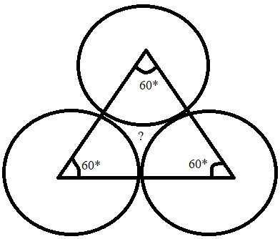

9) The area of the largest angle that can be inscribed in a semicircle of radius “r” is?
Sol) $Area=\frac{1}{2}×2r×r=r^{2}sq.units$
10) 3 circles of radius 3.5cm are placed in such a way that each circle touches the other two. Find the area of the portion enclosed by the circles?
Sol) $Req.Area=[\left(Area of equilateral triangle of side 7cm\right)−(3×area of sector with Θ=60ᶱ \& r=3.5cm)]$
$$=\left[\frac{\sqrt{3}}{4}{\left(7\right)}^{2}−\left(3×\frac{22}{7}×{\left(3.5\right)}^{2}×\frac{60}{360}\right)\right]$$
= 1.967 sq.cm.

Slide 18
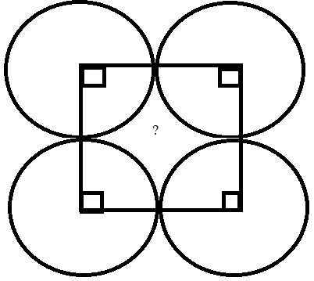

11) Four circular cardboard pieces, each of radius 7cm are placed in such a way that each piece touches two other pieces. Find the area of the space enclosed by the four pieces?
Sol) $Req Area={14}^{2}−\left[4×\frac{22}{7}×7^{2}×\frac{90}{360}\right]=42 sq.cm$

Slide 19

Volume and Surface Area
IMPORTANT FORMULAE
Cuboid:
Let length = l, breadth = b, & height = h units. Then,
$Volume= \left(l×b×h\right) cubic units.$
$Surface area=2\left(lb+bh+lh\right)sq.units$
Diagonal = $\sqrt{l^{2}+b^{2}+h^{2}} units$
Cube:
Let each edge of a cube be of length a. Then,
$Volume=a^{3} cubic units.$
$Surface area=6a^{2}sq.units$
Diagonal = $\sqrt{3} a units$

Slide 20

Cylinder:
Let radius of base = r and Height (or length) = h. Then,
$Volume=\left(ᴨr^{2}h\right)cubic units$
Curved surface area = $\left(2ᴨrh\right) sq. units$
Total surface area = ($2ᴨrh+2ᴨr^{2}$) sq. units = $2ᴨr\left(h+r\right)sq.units$
Cone:
Let radius of base = r & Height = h. Then,
Slant height, l = $\sqrt{h^{2}+r^{2}} units$
$Volume= \frac{1}{3}ᴨr^{2}h cubic units$
$Curved surface area=\left(ᴨrl\right)sq.units$
$Total surface area=\left(ᴨrl+ᴨr^{2}\right)sq.units$

Slide 21

Sphere:
Let the radius of the sphere be r. Then,
$Volume= \frac{4}{3}ᴨr^{3} cubic units$
$Surface area=4ᴨr^{2}sq units$
Hemisphere:
Le the radius of a hemisphere be r. Then,
$Volume= \frac{2}{3}ᴨr^{3} cubic units$
$Curved surface area=\left(2ᴨr^{2}\right)sq.units$
$Total surface area=\left(3ᴨr^{2}\right)sq.units$
Remember: 1 liter = 1000 ${cm}^{3}$

Slide 22

PROBLEMS
1) Find the volume and surface area of a cuboid 16m long, 14m broad and 7m high?
Sol) Volume = (16 × 14 × 7) cubic meter= 1568 cubic meters.
Surface area = [2(16×14+14×7+16×7)] sq.cm
= (2×434) sq.cm
= 868 sq.cm.
2) Find the length of the longest pole that can be placed in a room 12m long, 3m broad and 9m high?
Sol) length of longest pole = Length of the diagonal of the room
= $\sqrt{{12}^{2}+8^{2}+9^{2}}$
$$=\sqrt{289}$$
$$=17 m$$

Slide 23

3) The diagonal of a cube is $6\sqrt{3}cm.$ Find its volume and surface area?
Sol) Let the edge of the cube be a.
d = $\sqrt{3} a= 6\sqrt{3} ⇒a=6$
so, Volume = $a^{3}=\left(6×6×6\right)cubic cm$
$$=216 cubic cm$$
Surface area = $6a^{2}=\left(6×6×6\right)sq.cm$
$$=216 sq cm$$
4) The surface area of a cube is 1734 sq cm. Find its volume?
Sol) Let the edge of the cubic be a. Then,
$$6a^{2}=1734 ⇒ a^{2}=289 ⇒a=17cm$$
Volume = $a^{3}={17}^{3}$
$$=4913 cubic cm$$

Slide 24

5) A cube of edge 15cm is immersed completely in a rectangular vessel containing water. If the dimensions of the base of vessel are 20cm × 15cm, find the rise in water level?
Sol) Increase in volume = volume of the cube = (15×15×15) cubic cm
Rise in water level = $\left(\frac{Volume }{Area}\right)=\left(\frac{15×15×15}{20×15}\right)=11.25 cm$
6) 3 solid cubes of sides 1cm, 6cm & 8cm are melted to form a new cube. Find the surface area of the cube so formed?
Sol) Volume of new cube =($1^{3}+6^{3}{+8}^{3})$= 729 cubic cm
Edge of new cube = $\sqrt[3]{729} cm=9cm$
Surface area of the new cube = (6×9×9) sq cm = 486 sq cm.

Slide 25

7) Two cubes have their volumes in the ratio 1:27. Find the ratio of their surface areas?
Sol) Let their edges be a & b. Then, $$\frac{a^{3}}{b^{3}}=\frac{1}{27}or{ (\frac{a}{b})}^{3}{=(\frac{1}{3})}^{3 }or \frac{a}{b}=\frac{1}{3}$$
Ratio of their surface areas = $\frac{6a^{2}}{6b^{2}}=\frac{a^{2}}{b^{2}}{=(\frac{a}{b})}^{2}=\frac{1}{9}, i.e., 1:9$
8) Find the volume, curved surface area and the total surface area of a cylinder with diameter of base 7cm and height 40cm?
Sol) $Volume=\left(ᴨr^{2}h\right)=\left(\frac{22}{7}×\frac{7}{2}×\frac{7}{2}×40\right)=1540cubic cm$
Curved surface area = $\left(2ᴨrh\right)= \left(2×\frac{22}{7}×\frac{7}{2}×40\right)=880sq. cm$
Total surface area = ($2ᴨrh+2ᴨr^{2}$) sq. cm = $2ᴨr\left(h+r\right)sq.cm$
$$=\left(2×\frac{22}{7}×\frac{7}{2}×(40+3.5)\right) sq.cm=957 sq.cm$$

Slide 26

9) If the capacity of a cylinder tank is 1848 $m^{3}$ and the diameter of its base is 14m, then find the depth of the tank?
Sol) Let the depth of the tank be h meters. Then,
$$ᴨ×7^{2}×h=1848 ⇔h=\left(1848×\frac{7}{22}×\frac{1}{7×7}\right)=12m$$
10) Find the slant height, volume, curved surface area and the whole surface area of a cone of radius 21cm & height 28cm?
Sol) Here, r=21cm, & h=28cm
Slant height, l = $\sqrt{r^{2}+h^{2}}=\sqrt{{21}^{2}+{28}^{2}}=\sqrt{1225}=35cm$
$Volume= \frac{1}{3}ᴨr^{2}h=\left(\frac{1}{3}×\frac{22}{7}×21×21×28\right)=12936cubic cm$
$Curved surface area=\left(ᴨrl\right)=\left(\frac{22}{7}×21×35\right)=2310sq.cm$
$Total surface area=\left(ᴨrl+ᴨr^{2}\right)=\left(2310+\frac{22}{7}×21×21\right)=3696 sq.cm$

Slide 27

11) A closed metallic cylinder box is 1.25m high and its base radius is 35cm. if the sheet metal costs Rs.80 per $m^{2},$ the cost of the material used in the box?
Sol) Total surface area = $2ᴨr\left(h+r\right)=[2×\frac{22}{7}×\frac{35}{100}×(1.25+0.35)]m^{2}$
$$=\left(2×\frac{22}{7}×\frac{35}{100}×\frac{16}{10}\right)m^{2}=3.52m^{2}$$
$$Cost of the material=Rs.\left(3.52×80\right)=Rs.281.60$$
12) A cone, a hemisphere and a cylinder stand on equal bases and have the same height. Find the ratio of their volumes?
Sol) Let R be the radius of each.
Height of hemisphere = Its radius = R
Height of each = R.
Ratio of volumes = $\frac{1}{3}ᴨR^{2}×$R : $\frac{2}{3}ᴨR^{3}$: $ᴨR^{2}×$ R = 1 : 2 : 3

Slide 28

Surds and Indices
IMPORTANT FACTS & FORMULAE
LAWS OF INDICES:
$a^{m}×a^{n}=a^{m+n}$
$\frac{a^{m}}{a^{n}}=a^{m−n}$
${(a^{m})}^{n}=a^{mn}$
${ab}^{n}=a^{n}b^{n}$
${[\frac{a}{b}]}^{n}=\frac{a^{n}}{b^{n}}$
$a^{0}=1$
SURDS:
Let a be a rational number and n be a positive integer such that $a^{\frac{1}{n}}=\sqrt[n]{a}$ is irrational. Then, $\sqrt[n]{a}$ is called a surd of order n.

Slide 29

LAWS OF SURDS:
$\sqrt[n]{a}=a^{\frac{1}{n}}$
$\sqrt[n]{ab}=\sqrt[n]{a}×\sqrt[n]{b}$
$\sqrt[n]{\frac{a}{b}}=\frac{\sqrt[n]{a}}{\sqrt[n]{b}}$
${\left(\sqrt[n]{a}\right)}^{n}=a$
$\sqrt[m]{\sqrt[n]{a}=} \sqrt[mn]{a}$
${(\sqrt[n]{a})}^{m}= \sqrt[n]{a^{m}}$

Slide 30

PROBLEMS
1) Evaluate:
${(0.00032)}^{\frac{3}{5}}$
${(256)}^{0.16}×{(16)}^{0.18}$
Sol)
a) ${(0.00032)}^{\frac{3}{5}}$= ${(\frac{32}{100000})}^{\frac{3}{5}}={(\frac{2^{5}}{{10}^{5}})}^{\frac{3}{5}}={\{{(\frac{2}{10})}^{5}\}}^{\frac{3}{5}}={(\frac{1}{5})}^{(5×\frac{3}{5})}={\frac{1}{5}}^{3}=\frac{1}{125}$
b) ${(256)}^{0.16}×{(16)}^{0.18}$= ${({16}^{2})}^{0.16}×{(16)}^{0.18}={(16)}^{(0.32+0.18)}=\left({16}^{\frac{1}{2}}\right)=4$
2) If $2^{x−1}+2^{x+1}=1280, then find the value of x?$
Sol)
$$2^{x−1}+2^{x+1}=1280 ⇔2^{x−1}\left(1+2^{2}\right)=1280⇔2^{x−1}=\frac{1280}{5}=256=2^{8}⇔x−1=8⇔x=9$$
Hence, x=9

Slide 31

3) If ${\left(\frac{1}{5}\right)}^{3y}=0.008, then find the value of {\left(0.25\right)}^{y}?$
Sol) ${\left(\frac{1}{5}\right)}^{3y}=0.008=\frac{8}{1000}=\frac{1}{125}={\frac{1}{5}}^{3}⇔3y=3⇔y=1$
$${\left(0.25\right)}^{y}={\left(0.25\right)}^{1}=0.25$$
4) Find the value of $\frac{6^{\frac{2}{3}}×\sqrt[3]{6^{7}}}{\sqrt[3]{6^{6}}}$?
Sol) $\frac{6^{\frac{2}{3}}×\sqrt[3]{6^{7}}}{\sqrt[3]{6^{6}}}=\frac{6^{\frac{2}{3}}×{{(6}^{7})}^{\frac{1}{3}}}{{{(6}^{6})}^{\frac{1}{3}}}=\frac{6^{\frac{2}{3}}×6^{(7×\frac{1}{3})}}{6^{(6×\frac{1}{3})}}=\frac{6^{\frac{2}{3}}×6^{\frac{7}{3}}}{6^{2}}= 6^{\frac{2}{3}}×6^{(\frac{7}{3}−2)}=6^{\frac{2}{3}}×6^{\frac{1}{3}}=6^{(\frac{2}{3}+\frac{1}{3})}=6$
5) If $x=y^{a}, y= z^{b} \& z=x^{c}, then find the value of abc?$
Sol) $z^{1}=x^{c}={\left(y^{a}\right)}^{c}$
$$=y^{ac}={(z^{b})}^{ac}=z^{abc}$$
$$abc=1$$

Slide 32

7) $Simplify: {(\frac{x^{a}}{x^{b}})}^{(a^{2}+b^{2}+ab)}×{(\frac{x^{b}}{x^{c}})}^{(b^{2}+c^{2}+bc)}×{(\frac{x^{c}}{x^{a}})}^{(c^{2}+a^{2}+ac)}$
$sol)$Given Expression = ${\{x^{(a−b)}\}}^{{(a}^{2}+b^{2}+ab)}{.(x^{(b−c)})}^{(b^{2}+c^{2}+bc)}{.(x^{(c−a)})}^{(c^{2}+a^{2}+ac)}$
$$=x^{(a^{3}−b^{3})}.x^{(b^{3}−c^{3})}.x^{(c^{3}−a^{3})}$$
$$=x^{\left(a^{3}−b^{3}\right)+\left(b^{3}−c^{3}\right)+\left(c^{3}−a^{3}\right)}$$
$$=x^{0}=1$$
8) The value of $5^{\frac{1}{4}}×{125}^{0.25}?$
Sol) $5^{\frac{1}{4}}×{125}^{0.25}=5^{0.25}×{{(5}^{3})}^{0.25}=5^{0.25}×5^{(3×0.25)}=5^{0.25}×5^{0.75}=5^{(0.25+0.75)}=5^{1}=5$
9) ${\frac{1}{216}}^{−\frac{2}{3}}÷{\frac{1}{27}}^{−\frac{4}{3}}?$
Sol) =${216}^{\frac{2}{3}}÷{27}^{\frac{4}{3}}=\frac{{216}^{\frac{2}{3}}}{{27}^{\frac{4}{3}}}=\frac{{(6^{3})}^{\frac{2}{3}}}{{(3^{3})}^{\frac{4}{3}}}=\frac{6^{2}}{3^{4}}=\frac{36}{81}=\frac{4}{9}$

Slide 33

10) ${256}^{0.16}×{256}^{0.09}$
Sol) =${256}^{(0.16+0.09)}={256}^{0.25}={256}^{\frac{25}{100}}={256}^{\frac{1}{4}}={(4^{4})}^{\frac{1}{4}}=4$
11) ${17}^{3.5}×{17}^{?}={17}^{8}$
Sol) let ${17}^{3.5}×{17}^{x}={17}^{8}. Then, {17}^{3.5+x}={17}^{8}$
= $3.5+x=8⇔x=\left(8−3.5\right)⇔x=4.5$
12) ${18}^{3.5}÷{27}^{3.5}×6^{3.5}=2^{?}$
Sol) ${18}^{3.5}÷{27}^{3.5}×6^{3.5}=2^{x}$
⇔ ${18}^{3.5}×\frac{1}{{27}^{3.5}}×6^{3.5}=2^{x}⇔{(3^{2}×2)}^{3.5}×\frac{1}{{(3^{3})}^{3.5}}×{(2×3)}^{3.5}=2^{x}$
⇔$3^{(2×3.5)}×2^{3.5}×\frac{1}{3^{(3×3.5)}}×2^{3.5}×3^{3.5}=2^{x}$
⇔ $3^{7}×2^{3.5}×\frac{1}{3^{10.5}}×2^{3.5}×3^{3.5}=2^{x}⇔2^{7}=2^{x}⇔x=7$

Slide 34

13) ${\left(\frac{a}{b}\right)}^{x−1}={\left(\frac{b}{a}\right)}^{x−3}, then the value of x is?$
Sol) ${\left(\frac{a}{b}\right)}^{x−1}={\left(\frac{b}{a}\right)}^{x−3}⇔{\left(\frac{a}{b}\right)}^{x−1}={\left(\frac{a}{b}\right)}^{−(x−3)}={\left(\frac{a}{b}\right)}^{3−x}⇔x−1=3−x⇔2x=4⇔x=2$
14) $If 3^{\left(x−y\right)}=27 and 3^{\left(x+y\right)}=243, then x is equal to?$
Sol) $3^{\left(x−y\right)}=27=3^{3}⇔x−y=3 _______(1)$
$$3^{\left(x+y\right)}=243=3^{5}⇔x+y=5________(2)$$
$$On solving \left(1\right)\&\left(2\right), we get x=4$$
15) $Ifa^{x}=b^{y}=c^{z}and{ b}^{2}=ac then y equals?$
Sol) let $a^{x}=b^{y}=c^{z}=k. Then, a=k^{\frac{1}{x}}, b=k^{\frac{1}{y}} \& c=k^{\frac{1}{z}}$
$$b^{2}=ac⇔{(k^{\frac{1}{y}})}^{2}=k^{\frac{1}{x}}×k^{\frac{1}{z}}⇔k^{\frac{2}{y}}=k^{(\frac{1}{x}+\frac{1}{z})}$$
$$\frac{2}{y}=\frac{(x+z)}{xz}⇔\frac{y}{2}=\frac{xz}{(x+z)}⇔y=\frac{2xz}{(x+z)}$$

Slide 35

Logarithms
IMPORTANT FACTS & FORMULAE Logarithm: If ‘a’ is a positive real number, other than 1 and $a^{m}=x,$ then we write: ${m=log}_{a}{X}$ and we say that the value of $\log{X}$to the base ‘a’ is m.
Prosperities of Logarithm:
$\log_{a}{xy}=\log_{a}{x}{+log}_{a}{y}$
$\log_{a}{\frac{x}{y}}=\log_{a}{x}−\log_{a}{y}$
$\log_{a}{x}=1$
$\log_{a}{1}=0$
$\log_{a}{X^{p}}=p (\log_{a}{x})$
$\log_{a}{x}=\frac{1}{\log_{x}{a}}$
$\log_{a}{x}=\frac{\log_{b}{x}}{\log_{b}{x}}=\frac{\log{x}}{\log{a}}$
Common Logarithms: Logarithms to the base 10 are known as common logarithms.

Slide 36

The logarithm of a number contains two parts, namely characteristic & mantissa.
a) Characteristics: The integral part of the logarithm of a number is called its characteristics.
Case 1: When the number is greater than 1.
In this case, the characteristic is one less than the number of digits in the left of the decimal point in the given number.
Case 2: When the number is less than 1.
In this case, the characteristic is one more than the number if zeros between the decimal point and the first significant digit of the number and it is negative.
Instead of -1, -2 etc. We write, $\overline{1}, \overline{2} etc.$
b) Mantissa: the decimal part of the logarithm of a number is known as mantissa.
For mantissa, we look through log table.

Slide 37

Problems
1) If $\log_{\sqrt{3}}{x}=3\frac{1}{3}, find the value of x?$
Sol) $\log_{\sqrt{3}}{x}=\frac{10}{3}⇔x={(\sqrt{8})}^{\frac{10}{3}}={(2^{\frac{3}{2}})}^{\frac{10}{3}}=2^{(\frac{3}{2}×\frac{10}{3})}=2^{5}=32$
2) Simplify: $\log{\frac{75}{16}}−2log{\frac{5}{9}}+\log{\frac{32}{243}}?$
Sol) $\log{\frac{75}{16}}−2log{\frac{5}{9}}+\log{\frac{32}{243}}= \log{\frac{75}{16}}−\log{({\frac{5}{9})}^{2}+\log{\frac{32}{243}}}$
$$\log{\frac{75}{16}}− log{\frac{25}{81}}+\log{\frac{32}{243}}=\log\left(\frac{75}{16}×\frac{32}{243}×\frac{81}{25}\right)=\log{2}$$
3) If log 2 = 0.30103 & log 3 = 0.4771, find the values of
Log 25
log 4.5
Sol) a) log 25 = $\log\left(\frac{100}{4}\right)= \log{100}−\log{4}=2−2\log{2}=\left(2−2×0.3010\right)=1.398$
b) $\log{4.5}=\log\left(\frac{9}{2}\right)=\log{9}−\log{2}=2log{3}−\log{2}$
=(2×0.4771-0.3010) = 0.6532

Slide 38

4) If $\log_{8}{x}=\frac{2}{3}, then the value of x is?$
Sol) $\log_{8}{x}=\frac{2}{3}⇔x=8^{\frac{2}{3}}={(2^{3})}^{\frac{2}{3}}=2^{2}=4$
5) $If \log_{x}{y=100 \& \log_{2}{X}}=10, then the value of y is?$
Sol) $\log_{2}{X}=10⇒X=2^{10}$
$$\log_{x}{y=100⇒y=x^{100}={(2^{10})}^{100}=2^{1000}}$$
6) $2\log_{10}{5}+\log_{10}{8}−\frac{1}{2}\log_{10}{4}?$
Sol) $2\log_{10}{5}+\log_{10}{8}−\frac{1}{2}\log_{10}{4}=\log_{10}{5^{2}}+\log_{10}{8}−\log_{10}{4^{\frac{1}{2}}}$
$${=log}_{10}{25}+\log_{10}{8}−\log_{10}{2}=\log_{10}\left(\frac{25×8}{2}\right)=\log_{10}{100}=2$$

Slide 39

7) The value of $\log_{2}{\log_{2}{\log_{3}{\log_{3}{{27}^{3}}}}}?$
Sol) $\log_{2}{\log_{2}{\log_{3}{\log_{3}{{27}^{3}}}}}=\log_{2}{\log_{2}{\log_{3}{\log_{3}{{(3^{3})}^{3}=\log_{2}{\log_{2}{\log_{3}{\log_{3}{3^{9}}}}}}}}}$
$${=log}_{2}{\log_{2}{\log_{3}{(9\log_{3}{3})}=}}\log_{2}{\log_{2}{\log_{3}{9}}}$$
$${=log}_{2}{\log_{2}{[\log_{3}{3^{2}}]}}=\log_{2}{\log_{2}{({2log}_{3}{3})}}$$
$${=log}_{2}{\log_{2}{2}}=\log_{2}{1}=0$$
8) $\log_{4}{X}+\log_{2}{X}=6, then X is equal to ?$
Sol) $\log_{4}{X}+\log_{2}{X}=6⇔\frac{\log{X}}{\log{4}}+\frac{\log{X}}{\log{2}}=6$
$$⇔\frac{\log{x}}{2\log{2}}+\frac{\log{x}}{\log{2}}=6⇔3\log{x}=12\log{2}$$
$$⇔\log{x}=4log{2}⇔\log{x}=\log{2^{4}}=\log{16}⇔x=16$$

Slide 40

9) If $\log_{10}{125}+\log_{10}{8}=X, then X is equal to ?$
Sol) $\log_{10}{125}+\log_{10}{8}=X⇒\log_{10}\left(125×8\right)=X$
$${⇒x=log}_{10}{(1000)}=\log_{10}{{10}^{3}}=3\log_{10}{10}=3$$
10) If $\log_{5}\left(x^{2}+x\right)−\log_{5}{(x+1)}=2, then the value of X is?$
Sol) $\log_{5}{(x^{2}+x)}−\log_{5}\left(x+1\right)=2⇒\log_{5}{(\frac{x^{2}−x}{x+1}})=2$
$$⇒\log_{5}\left(\frac{x\left(x+1\right)}{x+1}\right)=2⇒\log_{5}{x}=2⇒x=5^{2}=25$$

Slide 41
Probability
IMPORTANT FACTS & FORMULAE:
Experiment: An operation which can produce some well-defined outcomes is called an experiment.
Random Experiment: An experiment in which all possible outcomes are known and the exact output cannot be predicted in advance, is called a random experiment.
Sample Space: When we perform an experiment then the set S of all possible outcomes is called the Sample Space.
Event: Any subset of a sample space is called an event.

Slide 42

Probability of Occurrence of an Event: Let S be the sample space and let E be an event. Then, E$⊊$S P(E) = $\frac{n(E)}{n(S)}$
Results on Probability:
P(S) = 1
$0≤P(E)≤1$
P($∅$) = 0
For any events A & B, we have: $P\left(A∪B\right)=P\left(A\right)+P\left(B\right)−P(A∩B)$
If $\overline{A}$ denotes ( not A), then P($\overline{A}$) = 1-P(A)

Slide 43

PROBLEMS
1) An unbiased die is tossed. Find the probability of getting a multiple of 3?
Sol) Here S = (HH, HT, TH, TT)
Let E = event of getting at most one head.
E = {TT, HT, TH}
P(E) = $\frac{n\left(E\right)}{n\left(S\right)}=\frac{2}{6}=\frac{1}{3}$
2) In a simultaneous throw of a pair of dice, find the probability of getting a total more than 7?
Sol) Here, n(S) = (6×6) = 36.
Let E = Event of getting a total more than 7
= {(2,6), (3,5), (3,6), (4,4), (4,5), (4,6), (5,3), (5,4), (5,5), (5,6), (6,2), (6,3), (6,4), (6,5), (6,6))
$$P\left(E\right)= \frac{n(E)}{n(S)}=\frac{15}{36}=\frac{5}{12}$$

Slide 44

3) A bag contains 6 white and 4 black balls. 2 balls are drawn at random. Find the probability that they are of the same color?
Sol) Let S be the sample space. Then,
n(S) = Number of ways of drawing 2 balls out of (6+4) = ¹⁰C₂ = $\frac{\left(10×9\right)}{\left(2×1\right)}=45.$
Let E= Event of getting both balls of the same colour. Then,
n(E) = Number of ways of drawing (2 balls out of 6) or (2 balls out of 4)
=(⁶C₂+⁴C₂) = $\frac{\left(6×5\right)}{\left(2×1\right)}+\frac{\left(4×3\right)}{\left(2×1\right)}=\left(15+6\right)=21$
$$P\left(E\right)=\frac{n(E)}{n(S)}=\frac{21}{45}=\frac{7}{15}$$
4) 3 unbiased coins are tossed. What is the probability of getting at most two heads?
Sol) Here S = {TTT, TTH, THT, HTT, THH, HTH, HHT, HHH}
Let E = event of getting at most two heads.
Then, E = {TTT, TTH, THT, HTT, THH, HTH, HHT}
$$P\left(E\right)=\frac{n(E)}{n(S)}=\frac{2}{6}=\frac{1}{3}$$

Slide 45

5) Tickets numbered 1 to 20 are mixed up & then a ticket is drawn at random. What is the probability that the ticket drawn has a number which is a multiple of 3 or 5?
Sol) Here, S={1,2,3,……,19,20}
Let E = event of getting a multiple of 3 or 5 = {3,6,9,12,15,18,5,10,20}
$$P\left(E\right)=\frac{n(E)}{n(S)}=\frac{2}{6}=\frac{1}{3}$$
6) One card is drawn at random from a pack of 52 cards. What is the probability that the card drawn is a face card?
Sol) Clearly, there are 52 cards, out of which there are 16 face cards.
P(getting a face card) = $\frac{16}{52}=\frac{4}{13}$
7) From a pack of 52 cards, one card is drawn at random. What is the probability that the card drawn is a ten or a spade?
Sol) Here, n(S)=52.
There are 13 spades (including one ten) and there are 3 more tens.
Let E= Event of getting a ten or a spade.
Then , n(E)=(13+3)= 16
$$P\left(E\right)=\frac{n(E)}{n(S)}=\frac{16}{52}=\frac{4}{13}$$

Slide 46

8) A box contains 5 green, 4 yellow & 3 white marbles. 3 marbles are drawn at random. What is the probability that they are not of the same color?
Sol) Let S be the sample space. Then,
n(S) = number of ways of drawing 3 marbles out of 12
¹²C₃ = $\frac{\left(12×11×10\right)}{\left(3×2×1\right)}=220$
Let E be the event of drawing 3 balls of the same color.
Then, E = event of drawing (3 balls out of 5) or (3 balls out of 4) or (3 balls out of 3)
$⇒n\left(E\right)$ = (⁵C₃+⁴C₃+³C₃) = (⁵C₂+⁴C₁+1) = $\frac{(5×4)}{(2×1)}+4+1=15$
$$P\left(E\right)=\frac{n(E)}{n(S)}=\frac{15}{220}=\frac{3}{44}$$
Required probability $=\left(1−\frac{3}{44}\right)=\frac{41}{44}$

Slide 47

9) A bag contains 2 red, 3 green & 2 blue balls. 2 balls are drawn at random. What is the probability that none of the balls drawn is blue?
Sol) Total number of balls = (2+3+2) = 7
Let S be the sample space. Then,
n(S) = Number of ways of drawing 2 balls out of 7 = ⁷C₂=$\frac{7×6}{2×1}=21$
Let E= Event of drawing 2 balls out of (2+3) balls
=⁵C₂=$\frac{5×4}{2×1}=10$
$P\left(E\right)=\frac{n(E)}{n(S)}=\frac{10}{21}$
10) In a box, there are 8 red, 7 blue & 6 green balls. One ball is picked up randomly. What is the probability that it is neither red nor green?
Sol) Total number of balls = (8+7+6)= 21
Let E = event that the ball drawn is neither red or green = event that the ball drawn is red.
n(E)=8
P(E)= $\frac{8}{21}$

Slide 48

11) A speaks truth in 75% cases and B in 80% of the cases. In what percentage of cases are they likely to contradict each other, narrating the same incident?
Sol) Let A = Event that A speaks the truth
And B = Event that B speaks the truth.
Then, P(A) = $\frac{75}{100}=\frac{3}{4}$, P(B) = $\frac{80}{100}=\frac{4}{5}$
P($\overline{A)}=\left(1−\frac{3}{4}\right)=\frac{1}{4} and P\left(\overline{B}\right)=\left(1−\frac{4}{5}\right)=\frac{1}{5}$
P(A & B contradict each other)
= P[(A speaks the truth and B tells a lie) or (A tells a lie and B speaks the truth)]
= P[(A and $\overline{B}$) or ($\overline{A} and B)$]
= P[(A and $\overline{B}$) + ($\overline{A} and B)$]
= P(A).P($\overline{B}$)+ P($\overline{A}$).P(B)
$$=\left(\frac{3}{4}×\frac{1}{5}\right)+\left(\frac{1}{4}×\frac{4}{5}\right)=\left(\frac{3}{20}+\frac{1}{5}\right)=\frac{7}{20}=\left(\frac{7}{20}×100\right)\%=35\%$$
$$A \& B cotradict each other in 35\% of the cases.$$

Slide 49

Permutations & Combinations
IMPORTANT FACTS & FORMULAE
Factorial Notation: Let n be a positive integer. Then, factorial n, denoted n! is defined as
n! =n(n-1)(n-2)……3.2.1.
Permutations: The different arrangements of a given number of things by taking some or all at a time, are called permutations.
Number of Permutations: Number of all permutations of ‘n’ things, taken ‘r’ at a time, is given by:
$${}_{}^{n}{P_{r}=n\left(n−1\right)\left(n−2\right)…………\left(n−r+1\right)=\frac{n!}{\left(n−r\right)!}}$$

Slide 50

An Important Result: If there are ‘n’ objects of which $P_{1}$ are alike of one kind; $P_{2}$ are alike of another kind; $P_{3}$ are alike of third kind and so on and $P_{r}$ are alike of rth kind, such that ($P_{1}+P_{2}$ +$P_{3}+..+ P_{r}$) = n.
Then, number of permutations of these n objects is :
$$\frac{n!}{\left(P_{1}!\right).\left(P_{2}!\right)……(P_{r}!)}$$
Combinations: Each of the different groups or selections which can be formed by taking some or all of a number of objects, is called combination.
Number of Combination: The number of all combinations of n things, taken r at a time is:
^{n}C_{r}$=\frac{n!}{\left(r!\right)\left(n−r\right)!}=\frac{n\left(n−1\right)\left(n−2\right)……to r factors}{r!}$
Note that: ^{n}C_{r} $=1 \&$^{n}C₀ = 1
An Important Result: ^{n}C_{r} $=$^{n}C_{(n-r)}

Slide 51

PROBLEMS
$Find the value of$
⁶⁰P₃
⁴P₄
⁶⁰P₃=$\frac{60!}{\left(60−3\right)!}=\frac{60!}{57!}=\frac{60×59×58×57!}{57!}=205320$
⁴P₄= 4! = (4×3×1×2)= 24.
2) Find the value of
¹⁰C₃
¹⁰⁰C₉₈
⁵⁰C₅₀
¹⁰C₃=$\frac{10×9×8}{3!}=\frac{10×9×8}{3×2×1}=120$
¹⁰⁰C₉₈= ¹⁰⁰C₍₁₀₀₋₉₈₎=¹⁰⁰C₂=$\frac{100×99}{2×1}=4950$
⁵⁰C₅₀= 1

Slide 52

3) How many words can be formed by using all the letters of the word DAUGHTER so that the vowel always come together?
Sol) Given word contains 8 different letters. When the vowels AUE are always together we may suppose them to form an entity, treated as one letter.
Then, the letters to be arranged are DGHTR (AUE)
These 6 letters can be arranged in ⁶P₆=6!=720 ways.
The vowels in the group (AUE) may be arranged in 3!=6 ways.
Required number of words = (720×6)= 4320.
4) In how many ways can the letters the word LEADER be arranged?
Sol) The word “LEADER” contains 6 letters, namely 1L, 2E, 1A, 1D & 1R
Required number of ways = $\frac{6!}{(1!)(2!)(1!)(1!)(2!)}=360$

Slide 53

5) In how many different ways can the letters of the word RUMOUR be arranged?
Sol) The word “RUMOUR” contains 6 letters, namely 2R, 2U, 1M & 1U
Required number of ways = $\frac{6!}{(2!)(2!)(1!)(1!)}=180$
6) How many words can be formed from the letters of the word SIGNATURE so that the vowels always come together?
Sol) The word SIGNATURE contains 9 different letters
When the vowels IAUE are taken together, they can be supposed to form an entity, treated as one letter.
Then, the letters to be arranged are SGNTR(IAUE).
These 6 letters can be arranged in ⁶P₆ = 6! = 720 ways.
The vowels in the group (IAUE) can be arranged amongst themselves in ⁴P₄ = 4! = 24 ways
Required number of words = (720×24) = 17280.

Slide 54

7) In how many different ways can the letters of the word JUDGE be arranged in such a way that the vowels always come together?
Sol) The word JUDGE has 5 different letters.
When the vowels UE are always together, they can be supposed to form one letter.
Then, we have to arrange the letters JDG (UE)
Now, 4 letters can be arranged in 4! = 24 ways
The vowels (UE) can be arranged among themselves is 2! = 2 ways.
Required number of ways = 24×2 = 48.
8) In how many different ways can the letters of the word CORPORATION be arranged so that the vowels always come together?
Sol) In the word “CORPORATION” we treat the vowels OOAIO as one letter. Thus, we have CRPRTN (OOAIO).
This has 7 letters of which R occurs 2 times and the rest are different.
Number of ways of arranging these letters = $\frac{7!}{2!}=2520$
Now 5 vowels in which O occurs 3 times and the rest are different, can be arranged in $\frac{5!}{3!}=20 ways$
Required number of ways = 2520×20 = 50400.

Slide 55

9) In how many different ways can the letters of the word DETAIL be arranged in such a way that the vowels occupy only the odd positions?
Sol) There are 6 letters in the given word out of which there are 3 vowels & 3 consonants.
Now, 3 vowels can be placed at any of the three places out of 4, marked 1,3,5.
Number of ways of arranging the vowels = ³P₃ =3! = 6
Also, the consonants can be arranged at the remaining 3 positions.
Number of ways of these arrangements = ³P₃ =3! = 6
Total number of ways = 6×6 = 36.
10) In how many ways can a group of 5 men and 2 women be made out of a total of 7?
Sol) Required number of ways = (7C5×3C2) = (7C2×3C1) = $\left(\frac{7×6}{2×1}×3\right)=63$

Slide 56

11) A box contains 2 white balls, 3 black balls & 4 red balls. In how many ways can 3 balls be drawn from the box, if at least one black ball is to be included in the draw?
Sol) We may have (1 black and 2 non-black) or (2 black & 1 non-black) or (3black).
Required number of ways = (3C1×6C2)+(3C2×6C1)+(3C3)
$$=\left(3×\frac{6×5}{2×1}\right)+\left(\frac{3×2}{2×1}×6\right)+1=\left(45+18+1\right)=64$$

Slide 57
Tabulation
1) The following table gives the sales of batteries manufactured by a company over the years. Study the table and answer the questions that follow.
NUMBER OF DIFFERENT TYPES OF BATTERIES SOLD BY A COMPANY OVER THE YEARS (NUMBERS IN THOUSANDS)
YEARS | TYPES OF BATTERIES
 | 4AH | 7AH | 32AH | 35AH | 55AH | TOTAL
1992 | 75 | 144 | 114 | 102 | 108 | 543
1993 | 90 | 126 | 102 | 84 | 126 | 528
1994 | 96 | 114 | 75 | 105 | 135 | 525
1995 | 105 | 90 | 150 | 90 | 75 | 510
1996 | 90 | 75 | 135 | 75 | 90 | 465
1997 | 105 | 60 | 165 | 45 | 120 | 495
1998 | 115 | 85 | 160 | 100 | 145 | 605

Slide 58
1) The total sales of all the seven years is the maximum for which battery?
Sol) The total sales of all the seven years for various batteries are
4AH = 75+90+96+105+90+105+115=676
7AH=144+126+114+90+75+60+85=694
32AH= 114+102+75+150+135+165+160=901
35AH=102+84+105+90+75+45+100=601
55AH=108+126+135+75+90+120+145=799
Clearly sales are maximum in case of 32AH batteries.
2)What is the difference in the number of 35AH batteries sold in 1993 & 1997?
Sol) Required difference = [(84-45)x1000]=39000

Slide 59

3) The percentage of 4AH batteries sold to the total number of batteries sold was maximum in the year------?
Sol) The % of sales of 4AH batteries to the total sales in different years are:
For $1992=\left(\frac{75}{543}×100\right)\%=13.81\%$
$1993=\left(\frac{90}{528}×100\right)\%=17.05\%$
$1994=\left(\frac{96}{525}×100\right)\%=18.29\%$
$1995=\left(\frac{105}{510}×100\right)\%=20.59\%$
$1996=\left(\frac{96}{465}×100\right)\%=19.35\%$
$1997=\left(\frac{105}{495}×100\right)\%=21.21\%$
$1998=\left(\frac{115}{605}×100\right)\%=19.01\%$
4) In the case of which battery there was a continuous decrease in sales from 1992 to 1997?
Sol) From the table it is clear that the sales of 7AH batteries have been decreasing continuously from 1992 to 1997.
5) What was the approximate % increase in the sales of 55AH batteries in 1998 compared to that in 1992?
Sol) Required Percentage $=\left[\frac{\left(145−108\right)}{108}×100\right]\%=34.26\%=34\%$

Slide 60
2) The following table gives the % of marks obtained by seven students in 6 different subjects in an examination. Study the table and answer the questions based on it. The numbers in the brackets given the maximum marks in each subject
Subjects\ students | Maths (150) | Chemistry (130) | Physics (120) | Geography (100) | History (60) | Computer science (40)
Ayush | 90 | 50 | 90 | 60 | 70 | 80
Aman | 100 | 80 | 80 | 40 | 80 | 70
Sajal | 90 | 60 | 70 | 70 | 90 | 70
Rohit | 80 | 65 | 80 | 80 | 60 | 60
Muskan | 80 | 65 | 85 | 95 | 50 | 90
Tanvi | 70 | 75 | 65 | 85 | 40 | 60
Tarun | 65 | 35 | 50 | 77 | 80 | 80

Slide 61

1) What was the aggregate of marks obtained by sajal in all the 6 subjects?
Sol) Aggregate marks obtained by Sajal
= (90% of 150)+(60% of 130)+(70% of 120)+(70% of 100)+(90% of 60)+(70% of 40) =135+78+84+70+54+28 = 449
2) What is the overall % of Tarun?
Sol) Aggregate marks obtained by Tarun
= (65% of 150)+(35% of 130)+(50% of 120)+(77% of 100)+(80% of 60)+(80% of 40) =97.5+45.5+60+77+48+32 = 360
Total maximum marks = (150+130+120+100+60+40) = 600
Overall % of Tarun = ($\frac{360}{600}×100$)% = 60%

Slide 62

3) What are the average marks obtained by all the seven students in physics?
Sol) Average marks obtained in physics by all the seven students
= $\frac{1}{7}(\left(90\% of 120\right)+\left(80\% of 120\right)+\left(70\% of 120\right)+\left(80\% of 120\right)+\left(85\% of 120\right)+\left(65\% of 120\right)+\left(50\% of 120\right)$)
= $\frac{1}{7}×\left(90+80+70+80+85+65+50)\%\right) of 120$
= $\frac{1}{7}×520\% of 120= \frac{624}{7}=89.14$
4) The number of students who obtained 60% and above marks in all the subjects is?
Sol) From the table it is clear that sajal and Rohit have 60 % or more marks in each of the six subjects.

Slide 63

5) In which subject is the overall percentage the best?
Sol) $Maths=\left[\frac{1}{7}×[90+100+90+80+80+70+65]\right]\%=82.14\%$
$Chemistry=\left[\frac{1}{7}×[50+80+60+65+65+75+35]\right]\%=61.43\%$
$Physics=\left[\frac{1}{7}×\left[90+80+70+80+85+65+50\right]\right]\%=74.29\%$
$Geography=\left[\frac{1}{7}×[60+40+70+80+95+85+77]\right]\%=72.43\%$
$History=\left[\frac{1}{7}×[70+80+90+60+50+40+80]\right]\%=67.14\%$
$Computeer Science=\left[\frac{1}{7}×[80+70+70+60+90+60+80]\right]\%=72.86\%$
Clearly, this percentage is highest for maths.

Slide 64
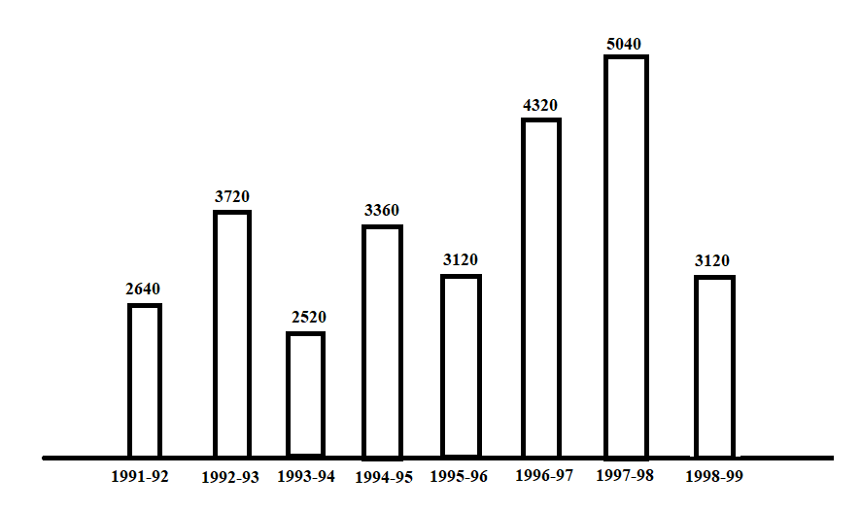
Bar Graphs
1)The bar graph given below shows the foreign exchange reserves of a country from 1991-92 to 1998-99. Answer the questions based on this graph

Slide 65

1) The foreign exchange reserves in 1997-98 was how many times that in 1994-95?
Sol) Required ratio = $\frac{5040}{3360}=1.5$
2) What was the % increase in the foreign exchange reserves in 1997-98 over 1993-94?
Sol) Foreign exchange reserves in 1997-98 = 5040 million US$
Foreign exchange reserves in 1993-94 = 2520 million US $
Increase = (5040-2520) = 2520 million US $
Percentage Increase = $\left(\frac{2520}{2520}×100\right)\%=100\%$

Slide 66

4) For which year, the % increase of foreign exchange reserves over the previous year, is the highest ?
Sol) The Percentage increase in reserves during these years compared to previous years are
$1992−93=\left[\frac{3720−2640}{2640}×100\right]\%=40.91\%$
$1994−95=\left[\frac{3360−2520}{2520}×100\right]\%=33.33\%$
$1996−97=\left[\frac{4320−3120}{3120}×100\right]\%=38.46\%$
$1997−98=\left[\frac{5040−4320}{4320}×100\right]\%=16.67\%$

Slide 67

5) The foreign exchange reserves in 1996-97 were approximately what % of the average foreign exchange reserves over the period under review?
Sol) Average foreign exchange reserves over the given period = $=\left[\frac{1}{8}×[2640+3720+2520+3360+3120+4320+5040+3120]\right]millionUS\$=3480 million US\$$
Foreign, exchange reserves in 1996-97=4320 million US $
Required Percentage $=\left(\frac{4320}{3480}×100\right)\%=124.14\%=125\%$
6) The ratio of the number of years, in which the foreign exchange reserves are above the average reserves, to those in which the reserves are below the average reserves?
Sol) Average foreign exchange reserves over the given period = 3480 million US $.
The country had reserves above 3480 million US $ during the years 1992-93, 1996-97 and 1997-98 i.e., for 3 years and below 3480 million US $ during the years 1991-92, 1993-94, 1994-95, 1995-96 & 1998-99. i.e, for 5 years.
Hence, required ratio = 3:5.

Slide 68
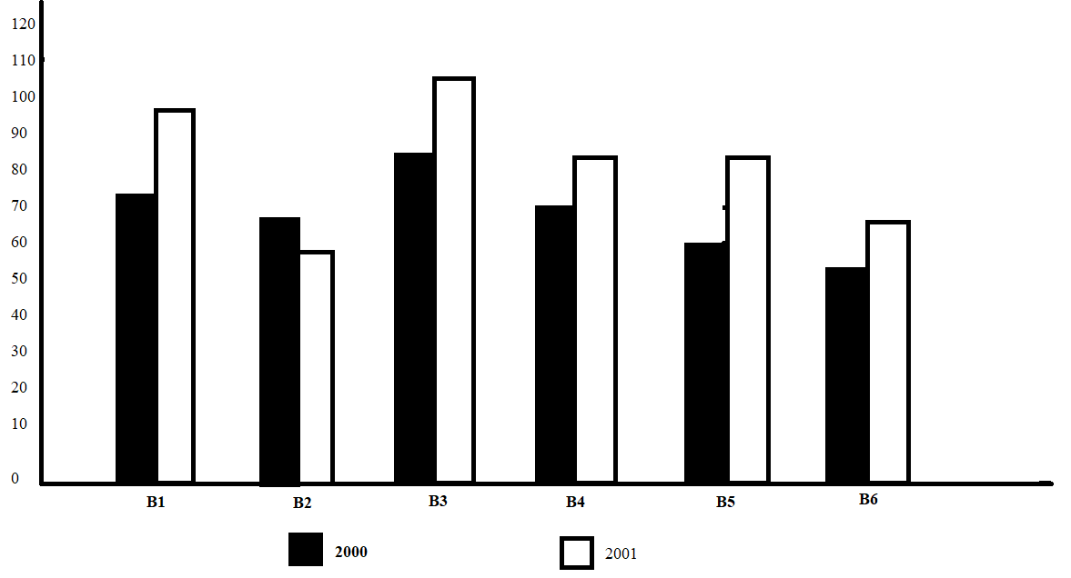
2) The bar-graph provided on next page gives the sales of books from six branches of a publishing company during two consecutive years 2000 & 20001. Answer the questions based on this bar graph.

Slide 69

1) Total sales of branches B1, B3 & B5 together for both the years (in thousand numbers) is?
Sol) Total sales of branches B!, B3 & B5 for both the years = 80+105+95+110+75+95 = 560
2) Total sales of branch B6 for both the years is what % of the total sales of branch B3 for both the years?
Sol) Required Percentage $=\left[\frac{70+80}{95+110}×100\right]\%=\left(\frac{150}{205}×100\right)\%=73.17\%$
3) What is the average sale of all the branches of the year 200?
Sol) Average sales of all the 6 branches for the years 2000 = $\frac{1}{6}×\left[80+75+95+85+75+70\right]=80$

Slide 70

4) What is the ratio of the total sales of branch B2 foe both years to the total sales of branch B4 for both years?
Sol) Required ratio = $\frac{75+65}{85+95}=\frac{140}{180}=\frac{7}{9}$
5) What % of the average sales of branches B1, B2 & B3 in 2001 is the average sales of branches B1, B3 & B6 in 200?
Sol) Average sales of branches B1, B3 & B6 in 2000 = $\frac{1}{3}×\left(80+95+70\right)=\frac{245}{3}$
Average sales of branches B1, B2 & B3 in 2001 = $\frac{1}{3}×\left(105+65+110\right)=\frac{280}{3}$
Required Percentage = $\left[\frac{\frac{245}{3}}{\frac{280}{3}}×100\right]\%=\left(\frac{245}{280}×100\right)\%=87.5\%$

Slide 71

Pie Charts
Important Facts & Formulae
The pie-chart or a pie graph is a method of representing a given numerical data in the form of sectors of a circle.
The sector of the circle are constructed in such a way that the area if each sector is proportional to the corresponding value of the component of the data.
From geometry, we know that the area of the sector of a circle is proportional to the central angle.
So, the central angle of each sector must be proportional to the corresponding value of the component.
Since the sum of all central angles is 360*, we have
$Central angle of the component=\left(\frac{Value of the component}{Total Value}×360\right)°$

Slide 72
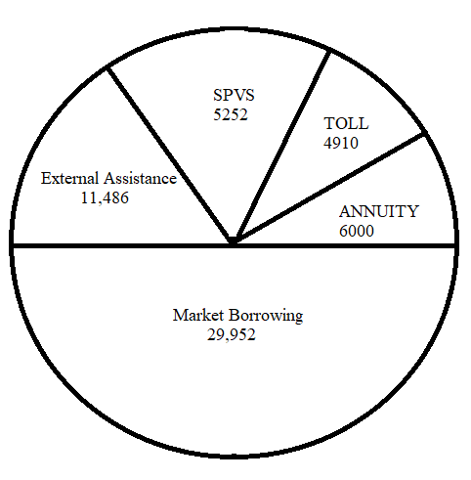
1)The following pie chart shows the sources of funds to be collected by the national highways Authority of India (NHAI) for its Phase 2 projects. Study the pie-chart and answer the questions that follows.
SOURCES OF FUNDS TO BE ARRANGED BY NHAI
FOR PHASE 2 PROJECTS (IN CRORES RS.)
Total funds to be arranged for Project Phase 2 = Rs. 57,600 crores.

Slide 73

1)Near about 20% of the funds are to arranged through?
Sol) 20% of the total funds to be arranged = rs(20% of 57600) crores = Rs.11520 crores = rs. 11486 crores.
Rs.11486 crores is the amount of funds to be arranged through External Assistance.
2) The Central angle corresponding to market Borrowing?
Sol) Central angle corresponding to market borrowing $=\left(\frac{29952}{57600}×360ᶱ\right)=187.2°$
3) The approximate ratio of the funds to be arranged through Toll & that through market Borrowing?
Sol) Required ratio = $\frac{4910}{29952}=\frac{1}{6.1}=\frac{1}{6}$

Slide 74

4) If NHAI could receive a total of Rs.9695 crores as external assistance, by what % should it increase the market borrowings to arrange for the shortage of funds?
Sol) Shortage of funds arranged through external assistance = (11486-9695) crores = Rs.1791 crores
Increase required in market borrowings = Rs.1791 crores
Percentage increase required $=\left[\frac{1791}{29952}×100\right]\%=5.98\%=6\%$
5) If the toll is to be collected through an outsourced agency by allowing a maximum 10% commission, how much amount should be permitted to be collected by the outsourced agency, so that the project is supported with Rs. 4910 crores?
Sol) Amount permitted = (funds required from toll for project of Phase 2) + (10% of these funds)
= Rs.4910 crores + Rs.(10% of 4910) crores
= Rs.(4910+491) crores = Rs. 5401 crores

Slide 75
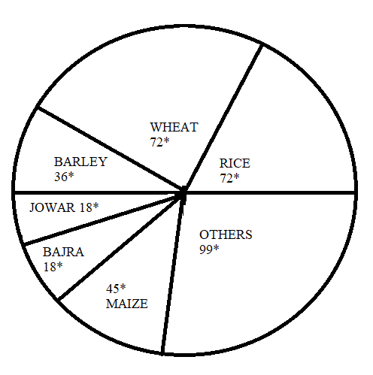
2) The pie chart provided below gives the distribution of land under various food crops. Study the pie chart carefully and answer the questions that follow
DISTRIBUTION OF AREAS (IN ACRES) UNDER VARIOUS FOOD CROPS

Slide 76

1) Which combination of 3 crops contribute to 50% of the total area under the food crops?
Sol) The total of the central angles corresponding to the 3 crops which covers 50% of the total area, should be 180*. Now, the total of the central angles for the given combinations are:
Wheat, Barley & Jowar = (72$°$+36$°$+18$°$)=126$°$
Rice, Wheat &Jowar = (72+72+18) = 162
Rice, wheat & Barley = (72+72+36)= 180$°$
Bajra, Maize & Rice = (18+45+72) = 135
Clearly 3rd one is the required combination.
2) If the total area under jowar was 1.5 million acres, then what was the area under rice?
Sol) The area under any of the food crops is proportional to the central angle corresponding to that crop.
Let, the area under rice production be X million acres.
Then, 18 : 72 = 1.5 : X ⇒ $x=\left(\frac{72×1.5}{18}\right)=6$
Thus the area under rice production = 6 million acres.

Slide 77

3) If the production of wheat is 6 times that of barley, then what is the ratio between the yield per acre of wheat and barely?
Sol) Let the total production of barley be T tons and let Z acres of land be put under barely production.
Then the total production of wheat = 6T tonnes
Also, area under wheat production = 2Z acreas.
$\left[\frac{Area under wheat production}{Area under Barley production}=\frac{72°}{36°}=2\right]$
Area under wheat = 2 × area under barley = 2Z acres
Now, yields per acre for wheat = $\frac{6T}{2Z}\frac{tonnes}{acre}=\frac{3T}{Z} tonnes/acre$
And yield per acre for barley = $\frac{T}{Z} tonnes/acre$
Required Ratio = $\left[\frac{\frac{3T}{Z}}{\frac{T}{Z}}\right]=3:1$

Slide 78

4) If the yield per acre of rice was 50% more than that of barley, then the production of barley is what % of that of rice?
Sol) Let Z acres of land be put under barley production.
Then, $\frac{area under rice production}{area under barley production }=\frac{72°}{36°}=2$
Area under rice production = 2 x area under barley production = 2Z acres.
Now, if p tonnes be the yield per acre of barley then , yiels per acre of rice = (p+50% of p) tonnes = ($\frac{3}{2}p$) tonnes.
Total production of rice = (yield per acre)x(area under production)= ($\frac{3}{2}p$)x2z= (3pZ)tonnes
Total production of barley = pZtonnes
Percentage production of barley to that of rice = $\left[\frac{pZ}{3pZ}×100\right]\%=33\frac{1}{3}\%$

Slide 79

5) If the total area goes up by 5%, and the area under wheat production goes up by 12%, then what will be the angle for wheat in the new pie chart?
Sol) initially, let t acres be the total area under consideration
Then area under wheat production initially was = $\frac{72}{360}×t$ acres = $\frac{t}{5} acres$
Now, if the total area under consideration be increased by 5%, then the new value of the total area = $[\frac{105}{100}t]acres$
Also, if the Area under wheat production be increased by 12%, then the new value of the area under wheat $=\left[\frac{t}{5}+\left(12\% of \frac{t}{5}\right)\right]acres=\left(\frac{112t}{500}\right)acres$
Central angle corresponding to wheat in the new pie chart
$=\left[\frac{area under wheat \left(new\right)}{Total area \left(new\right)}×360\right]°=\left[\frac{\left(\frac{112t}{500}\right)}{\left(\frac{105t}{100}\right)}×360\right]=76.8°$

Slide 80
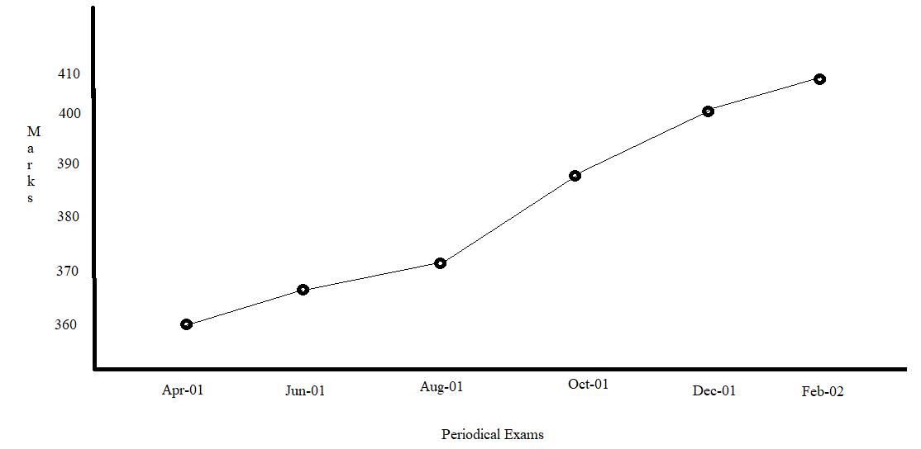
Line Graphs
1) In a school the periodical examinations are held every second month. In a session during Apr. 2001- Mar. 2002, a student of class 9 appeared for each of the periodical exams. The aggregate marks obtained by him in each periodical exam are represented In the line graph given below. Study the graph and answer the questions based on it.
MARKS OBTAINED BY A STUDENT IN 6 PERIODICAL EXAMS HELD IN EVERY 2 MONTHS DURING THE YEARD IN THE SESSION 2001-02
MAXIMUM TOTAL MARKS IN EACH PERIODICAL EXAM = 500

Slide 81

1) The total number of marks obtained in Feb-02 is what % of the total marks obtained in Apr-01?
Sol) $Required Percentage=\left(\frac{405}{360}×100\right)\%=112.5\%$
2) What are the average marks obtained by the student in all the periodical exams during the session?
Sol) Average marks obtained in all the periodical exams
$$=\frac{1}{6}×\left[360+365+370+385+400+405\right]=380.83=381$$
3) What is the % of marks obtained by the student in the periodical exams of Aug-01 & Oct-01 taken together?
Sol) $Required Percentage=\left[\frac{370+385}{500+500}×100\right]\%=\left(\frac{755}{1000}×100\right)\%=75.5\%$

Slide 82

4) In which periodical exams there is a fall in % of marks compared to the previous periodical exams?
Sol) As is clear from the graph, the total marks obtained in periodical exams, go on increasing. Since, the maximum marks for all the periodical exams are same, it implies that the % of marks also goes on increasing. Thus in none of the periodical exams, there is a fall in % of marks compared to the precious exams.
5) In which periodical exams did the student obtain the highest % increase in marks over the previous periodical exams?
Sol) Percentage increase in marks in various periodical exams compared to the previous exams are:
$Jun 01=\left[\frac{365−360}{360}×100\right]\%=1.39\%$
$Aug 01=\left[\frac{370−365}{365}×100\right]\%=1.37\%$
$Oct 01=\left[\frac{385−370}{370}×100\right]\%=4.05\%$
$Dec 01=\left[\frac{400−385}{385}×100\right]\%=3.90\%$
$Feb 02=\left[\frac{405−400}{400}×100\right]\%=1.25\%$

Slide 83
Thank You

